Slide 1
Project Presentation #3
Team E: Jiayu Yao, Shang Liu, Yuqiao Han

Slide 2
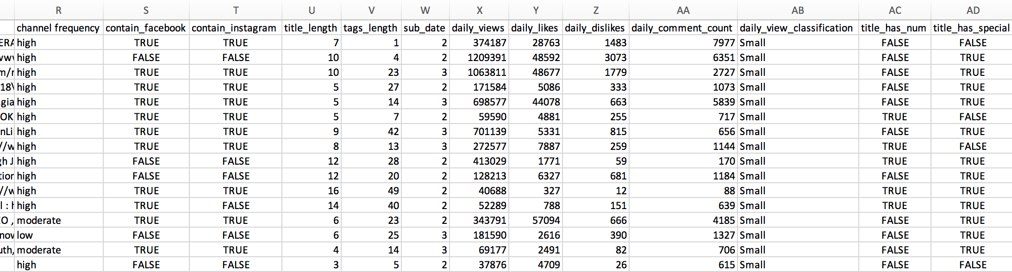
Goals
New Features
Analyze factors that highly affect on Youtube video popularity.
Find out the top ten rules and attributes that contribute to high views on YouTube.

Slide 3
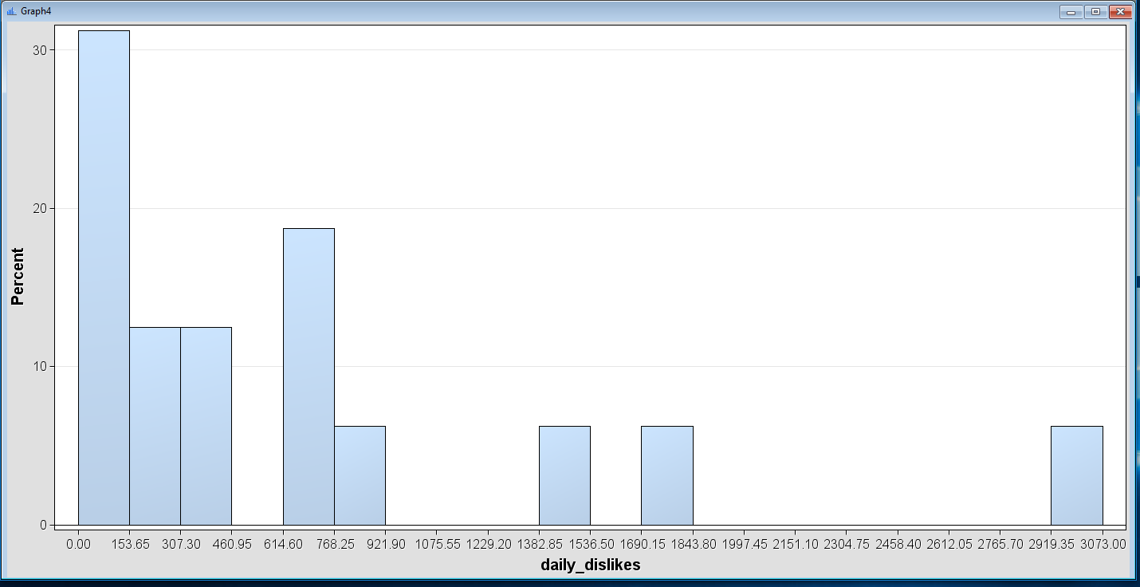
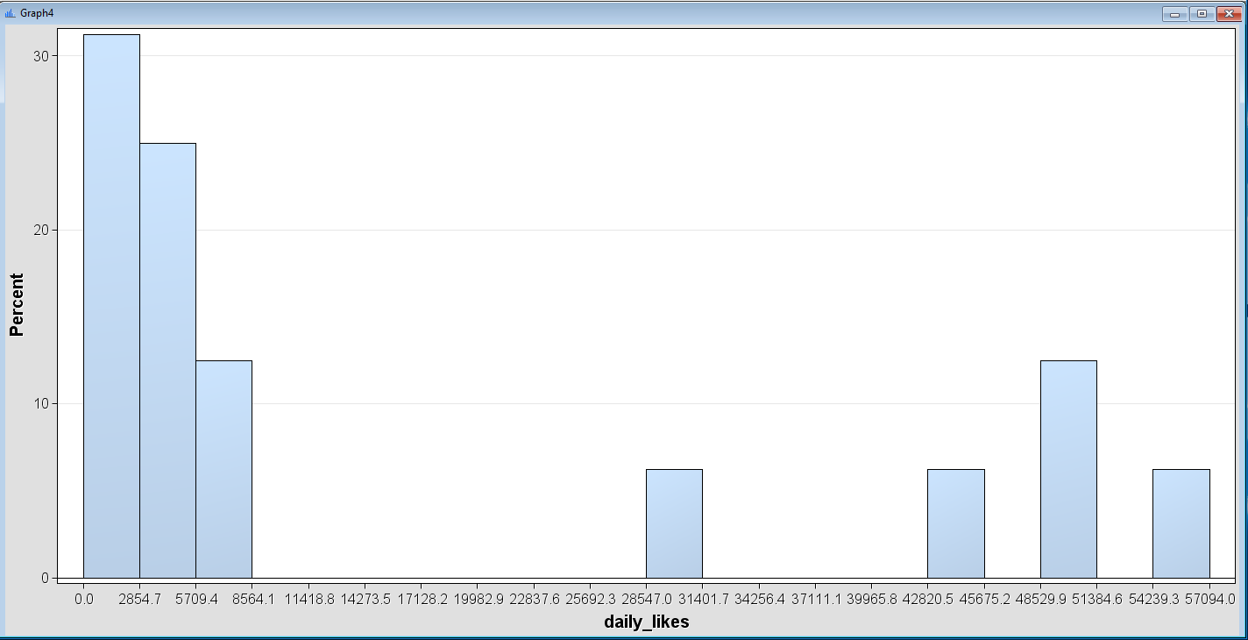
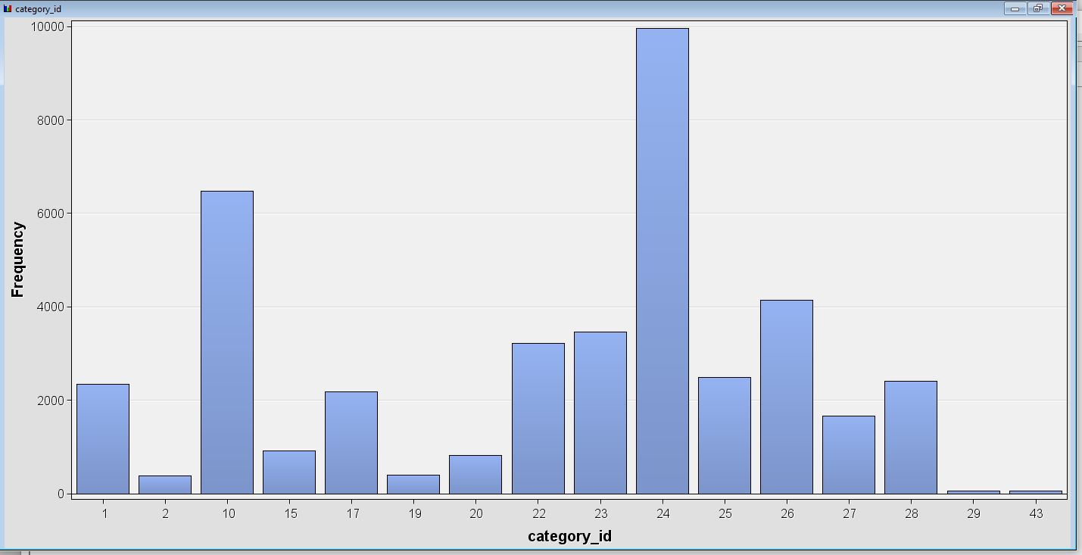
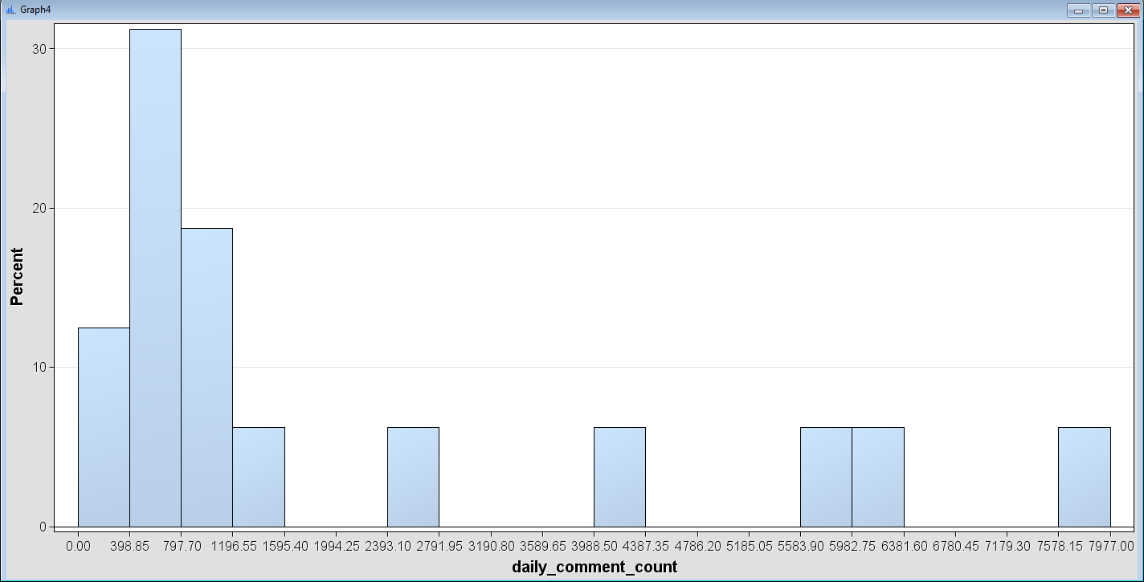
Calculate the days between publishing date and trending date
Calculate the daily comments, daily likes, daily dislikes, daily views
plot the distributation
daily dislikes
daily likes
category id
daily comments

Slide 4
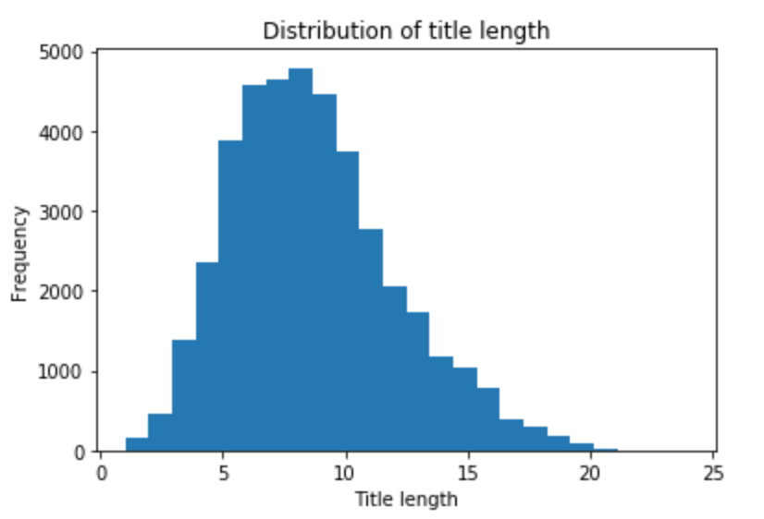
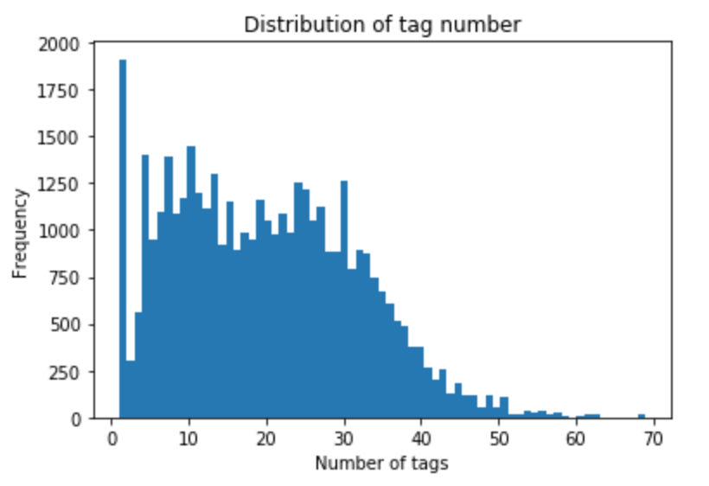
Distribution of title length and tags number
mean: 8.53 standard deviation: 12.35
mean: 19.74 standard deviation: 144.30

Slide 5
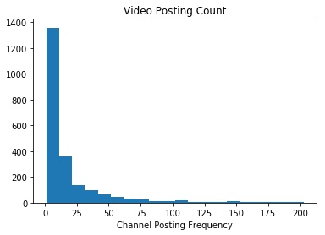
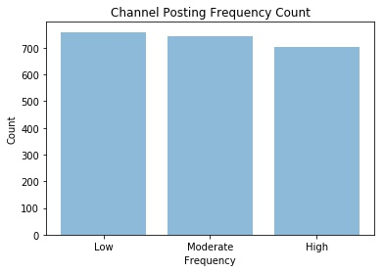
Video posting count for each channel in 213 days.
Define frequency threshold as:
Low: frequency <= 0.02, less than one video in 50 days.
Moderate: 0.02 < frequency <= 0.6, less than one video in 15 days.
High: frequency > 0.6, more than one videos posted in 15 days.
3. Add channel frequency (‘Low’, ‘Moderate’, ‘High’) as a new feature.

Slide 6
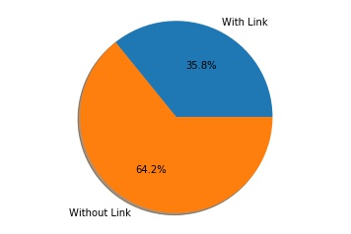
Social Media Link in Video Description
Ratio of whether the video contains Facebook or Instagram links in description
Add two new features: whether contians facebook links and whether contains instagram links (True or False)

Slide 7
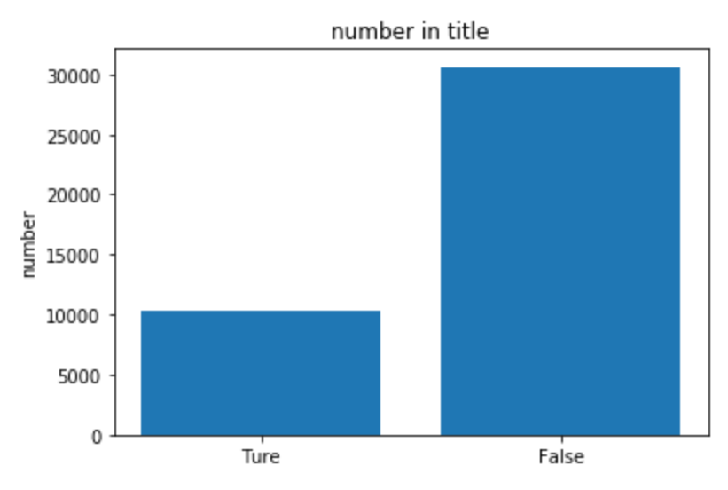
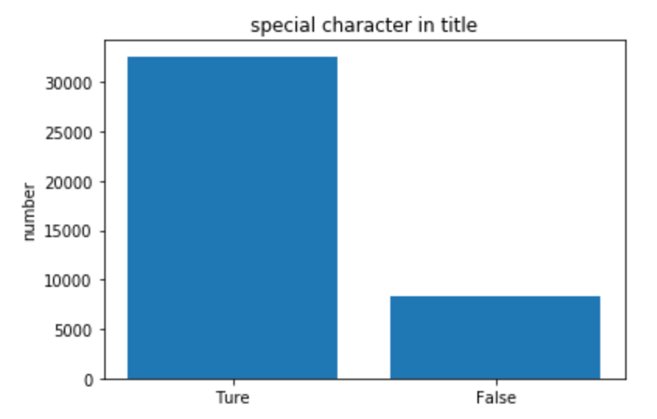
Special characters in title: This column contains the title contains special characters(such as “!” “?”), this feature has true or false as values.
Number in title: This column contains if the title contains number, this feature has true or false as values.

Slide 8
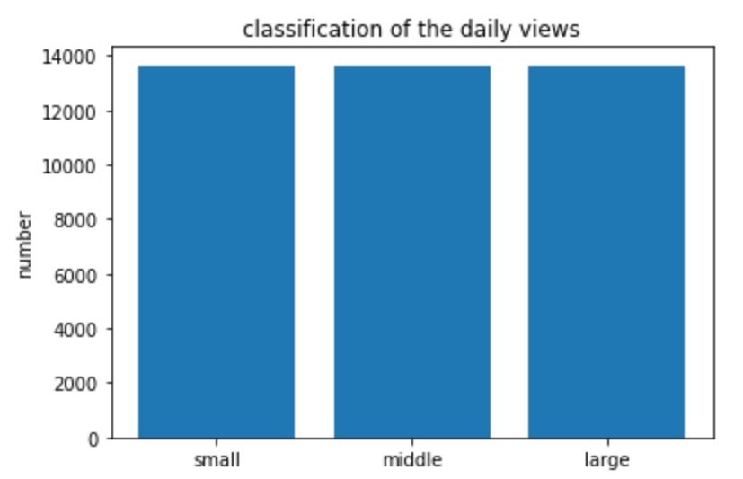
Classification of the daily views: In this column, we divide daily views into 3 tags “small”, ”middle”, ” large”, according to the values, each of tag has ⅓ of the total data.
Min : 0, ⅓: 56601, ⅔: 195065, Max:20932130

